Slide 1



SURVEY OF SALARY & EXPERIENCE ACROSS GLOBAL INDUSTRIES
An Analysis of Career Trajectories
ANUSHIYA.S

Slide 2




INTRODUCTION
This Salary Survey Report gives an overview of how employees at Global Company are paid across different countries and job roles.
The dataset is a collection of data from employees around the world, covering different levels of experience, departments, and regions.
The goal is to make sure our pay is competitive and fair, and to guide future decisions about salaries and benefits.
This report is an important step in ensuring that Global Company continues to be a great place to work and grow.
Global Company
An Analysis of Career Trajectories

Slide 3
REPORT HIGHLIGHTS
01
06
AGE GROUP
EXPERIENCE
02
07
GENDER
INDUSTRY
03
08
EDUCATION
JOB TITLE
04
09
COUNTRY
SALARY
05
10
STATE
ADDITIONAL COMPENSATION
GLOBAL Company
An Analysis of Career Trajectories

Slide 4

PROJECT OVERVIEW
1.DATA CLEANING-
HANDLE MISSING VALUES,
DATA STANDARDIZE,
FOUND INCONSISITENT VALUES,
DETECTED OUTLIERS
2.IMPORTED CLEANED DATA TO SQL:
3.SQL QUERIES ARE DONE
4.TABLE CREATED FOR EACH QUERIES
5.DASHBOARD CREATION
6.QUERY EXPORTED TO CSV FILE
7.WRITTEN SUMMARY
GLOBAL Company
An Analysis of Career Trajectories

Slide 5
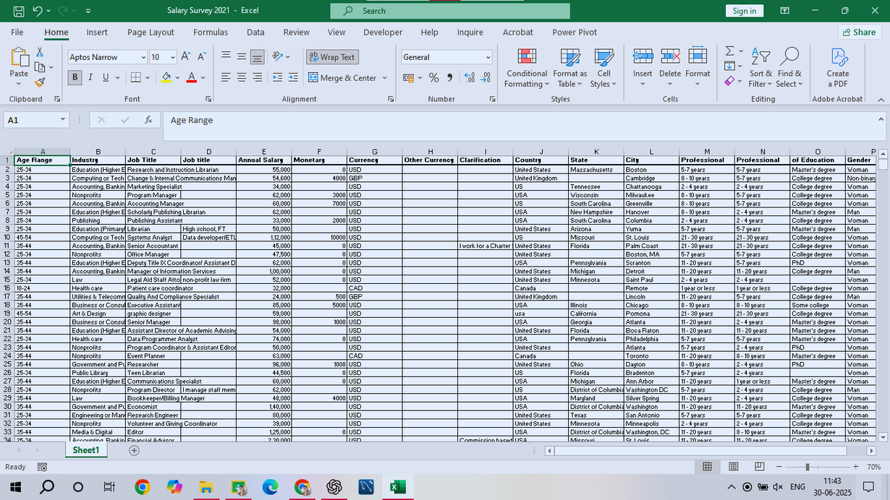
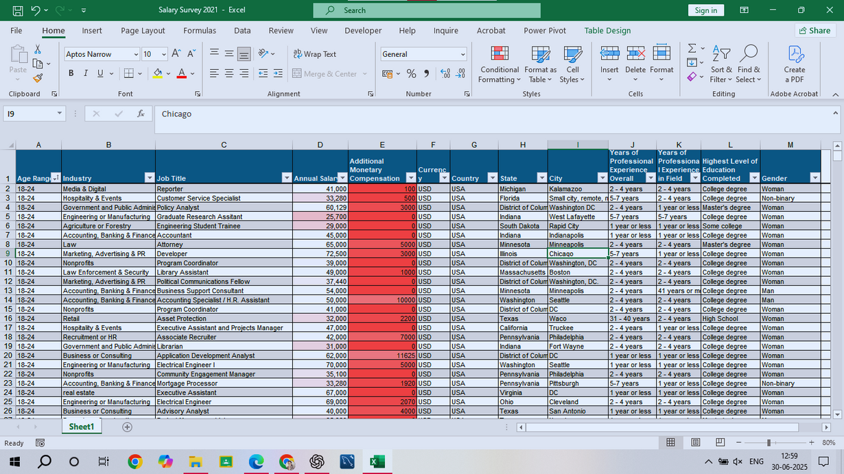
DATA CLEANING AND PROCESSING
RAW DATA
CLEAN DATA
GLOBAL Company

Slide 6
HIGHEST SALARY
Activity | Software Engineer 40712015 Senior Software Engineer 27928411 Director 23411228 | Master's degree 96620.85 0 5000044 | USA Inside sales manager 5000044
Outcome | Chicago-Accounting, Banking & Finance-130000.00 | Director 11 - 20 years 12451466 | Man Receives highest salary

Slide 7
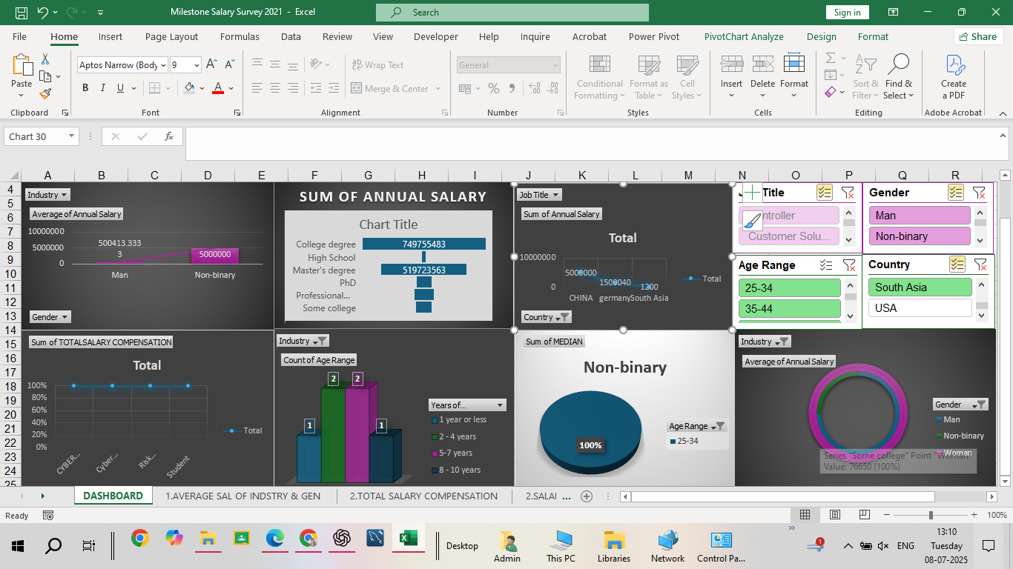
SALARY SURVAY DASHBOARD

Slide 8
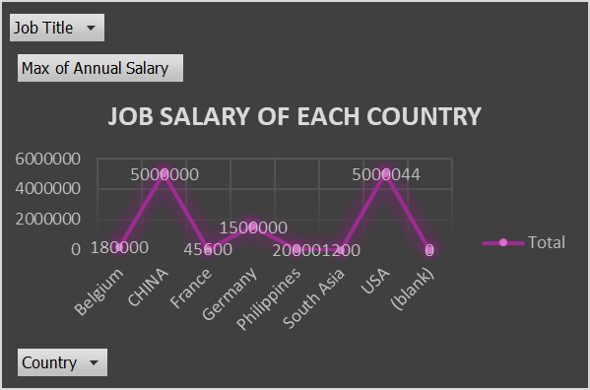
SALARY BY COUNTRY
This graph shows the average annual salary in various countries.
It helps compare pay levels across the globe and highlights where the highest and lowest salaries are found.

Slide 9
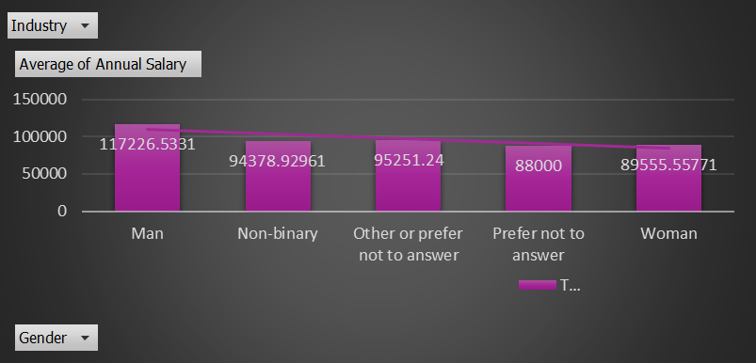
GENDERWISE SALARY
This chart compares the average yearly salary of male and female employees.
It helps us see if there is any pay gap between genders.
We can easily understand who earns more on average.
It highlights the need for equal pay and fairness in the workplace.

Slide 10

Conclusion
This salary survey project has provided meaningful insights into compensation patterns across various industries, job titles, education levels, and demographics.
The analysis highlighted disparities such as the gender pay gap and variations in salaries based on experience, education, and geographic location.
These findings can help organizations build fair, competitive, and data-driven compensation strategies, ensuring better talent retention and equity in the workplace.

Slide 11
ANY QUESTIONS

Slide 12
THANK YOU
08-07- 2025

